Slide 1
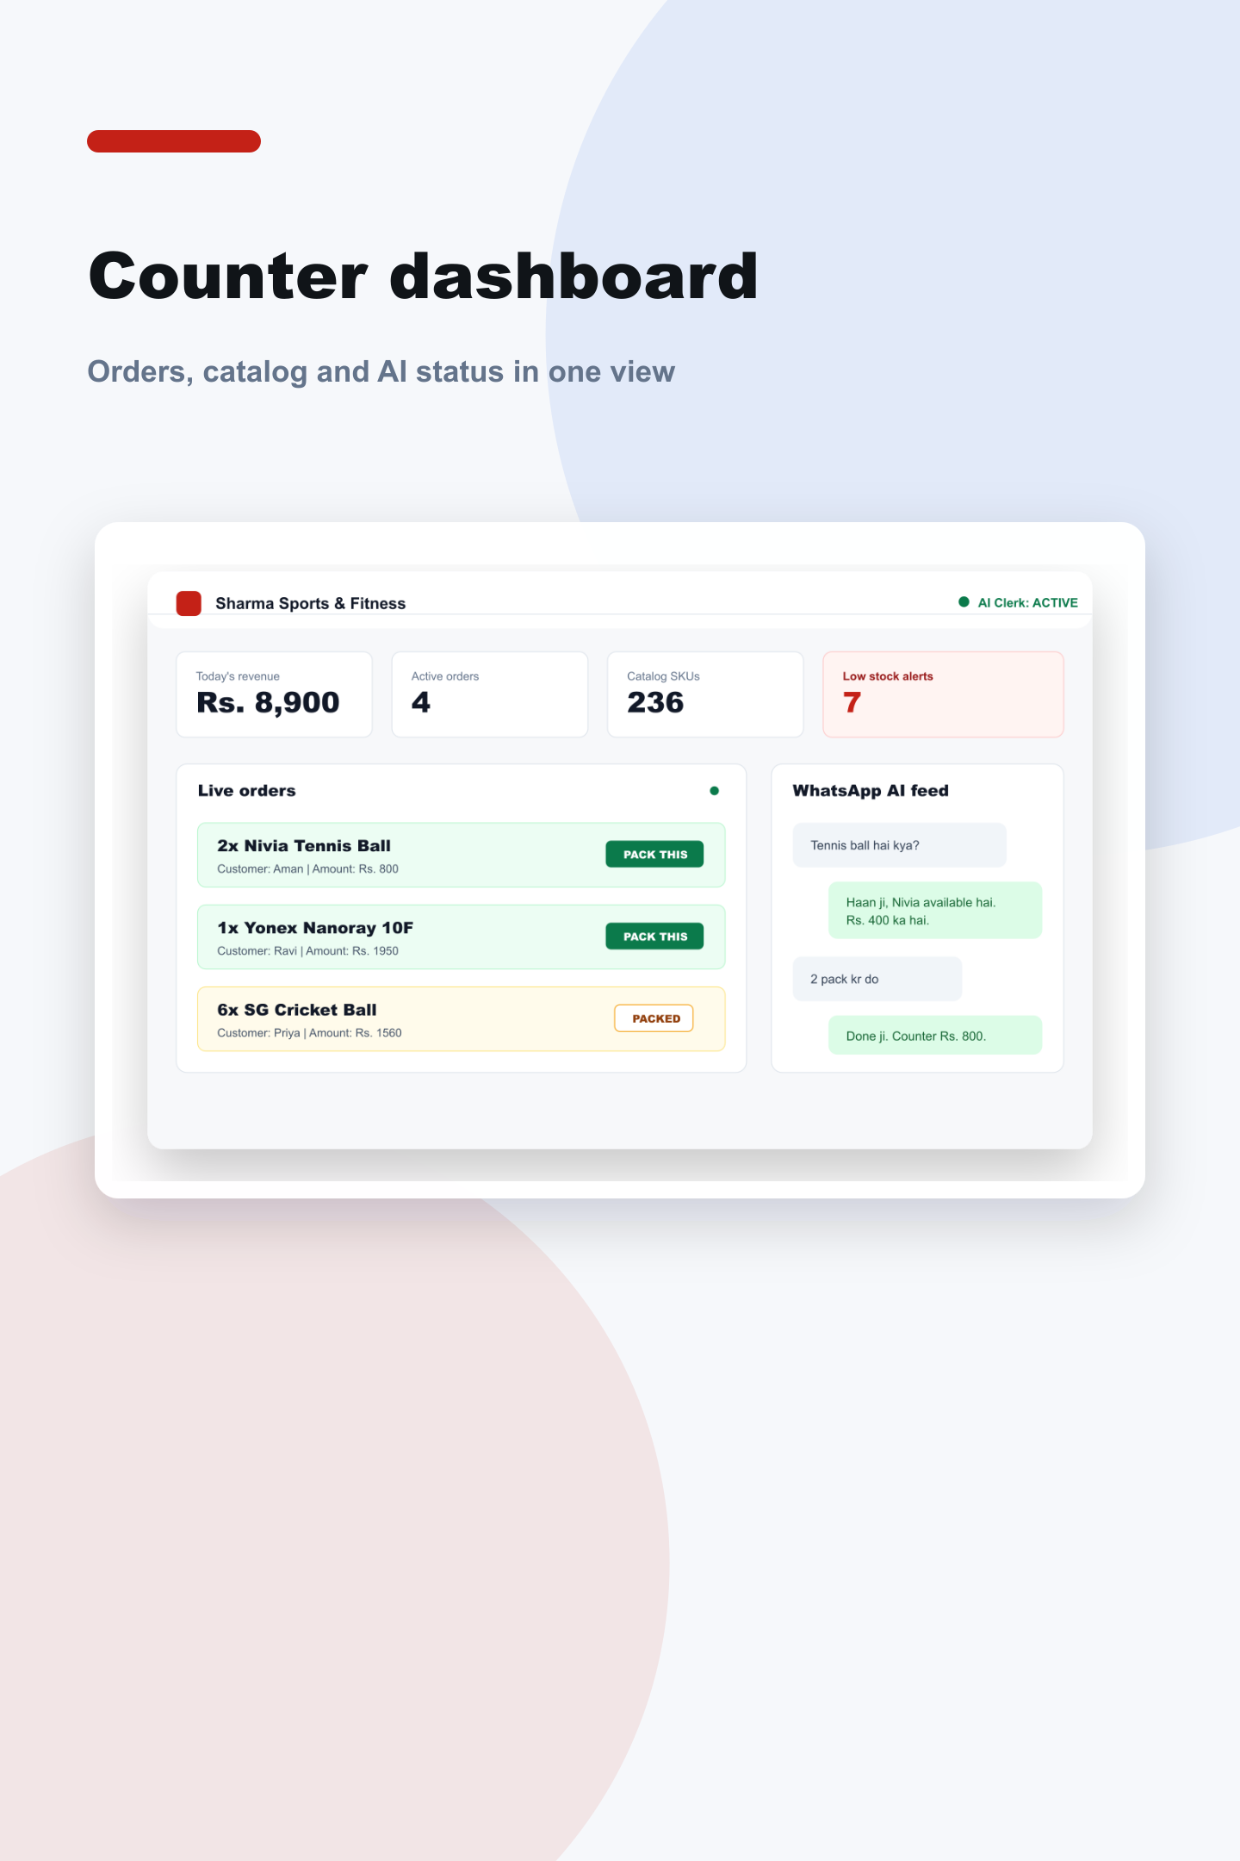
Your Shop. Your Catalog. Your AI Clerk.
Upgrade your retail store with a WhatsApp AI clerk that answers stock and price queries, reserves pickup orders, and alerts your counter dashboard — automatically.
SMART-CLERK.SOLVOR.CO.IN
SMART-CLERK-ENTERPRISE.SOLVOR.CO.IN

Slide 2
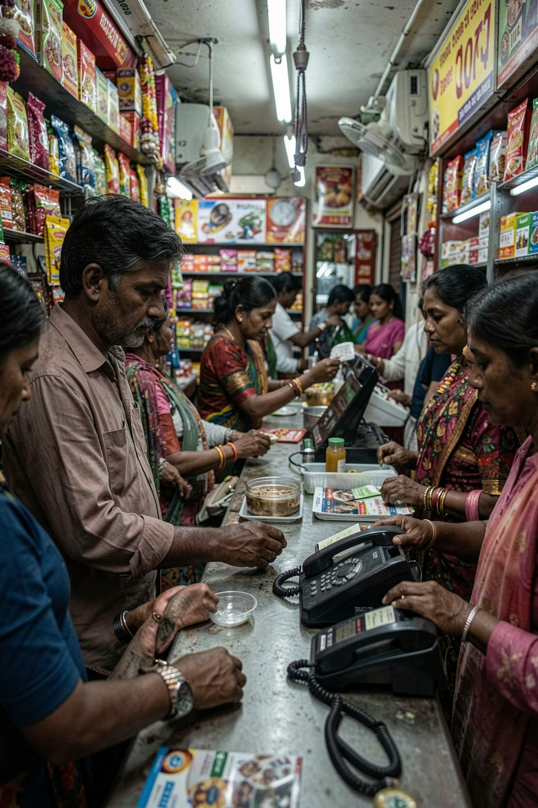
Busy counters lose WhatsApp sales every day.
👋 Owner is occupied
Serving walk-in customers at the counter — no time to check WhatsApp.
📵 Queries go unanswered
Price and stock messages pile up. Customers wait. Patience runs out.
🏃 They buy elsewhere
Competitors who reply faster win the sale — every single time.
📓 Data is scattered
Catalog lives in notebooks, memory, and half-updated Google Sheets.

Slide 3
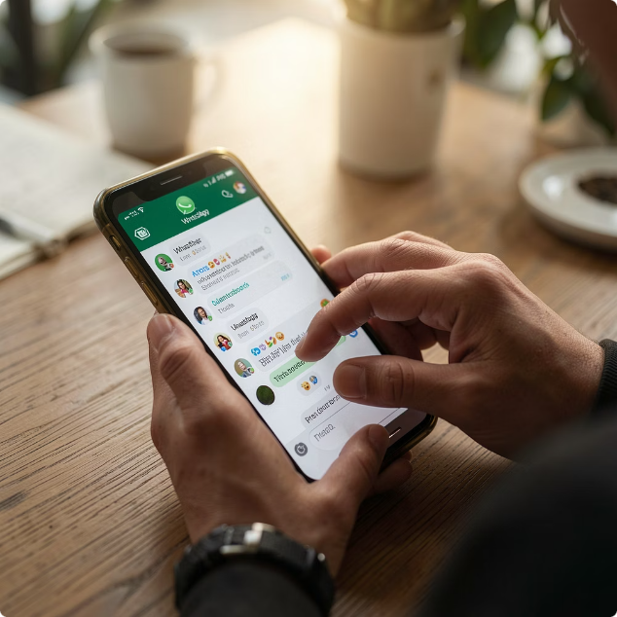
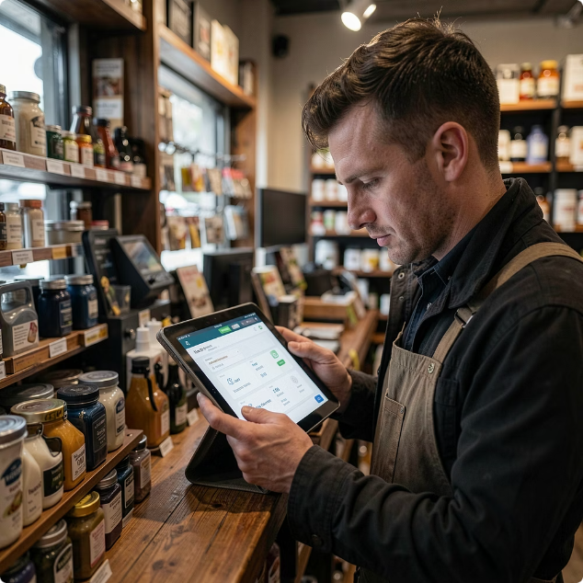
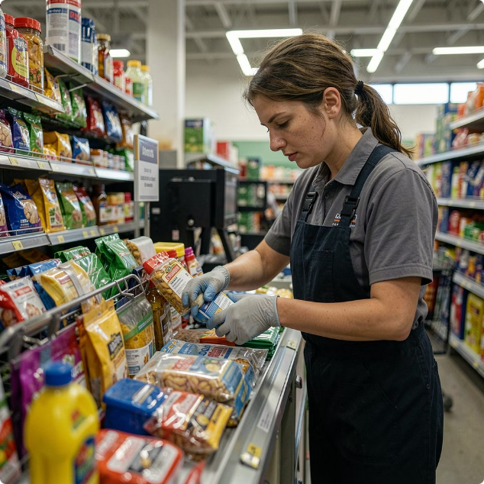
One Platform. Three Users Served.
Smart Clerk connects your customers, your counter, and your staff — all through a single AI-powered system.
Customers
Shop Owner
Staff
Ask on WhatsApp, get instant stock and price replies — no waiting, no calling.
Watch orders, stock levels, and AI conversations live from your dashboard.
Receive clear "Pack This Item" order cards — no confusion, no missed orders.

Slide 4

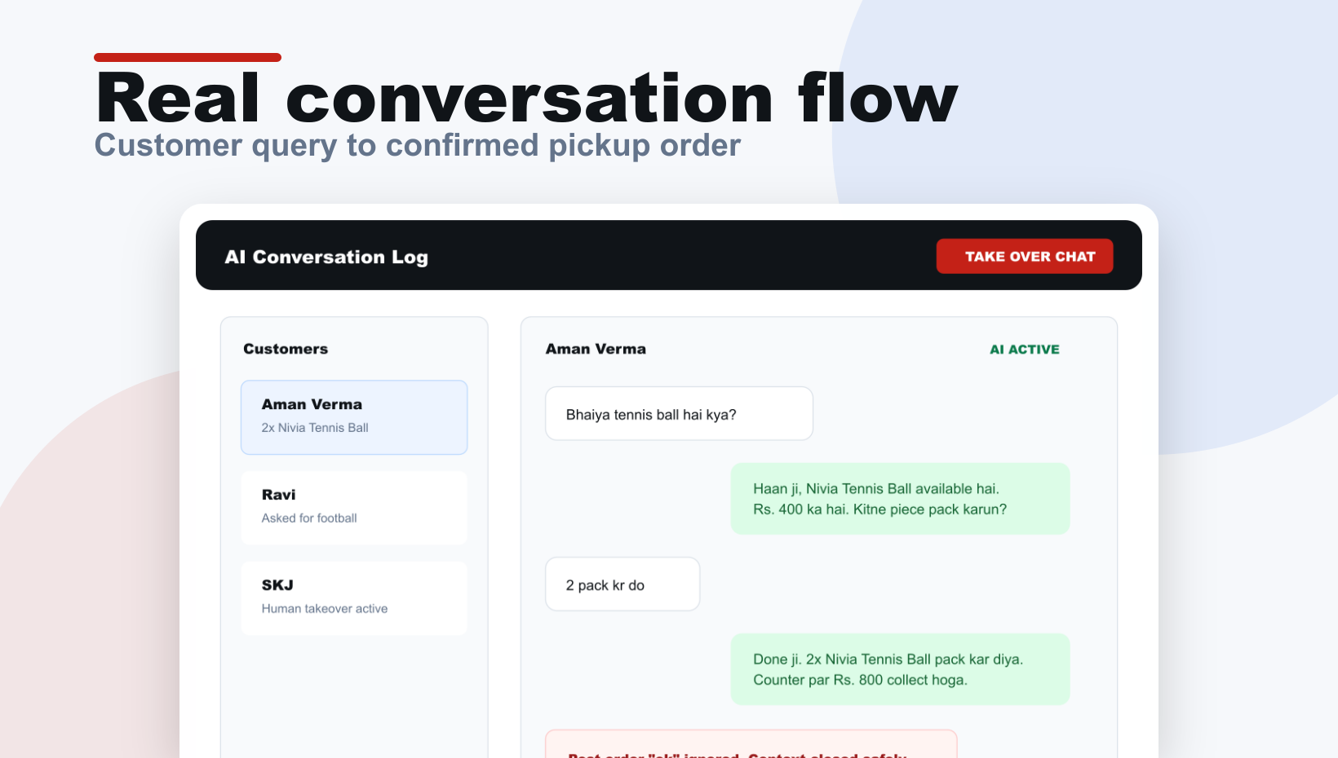


WHATSAPP AI CLERK
The AI clerk replies while the owner stays at the counter.
Customer asks: "Bhaiya Nivia tennis ball hai kya?"
AI instantly checks your catalog cache for stock and price.
Replies in Hinglish with availability and price details.
Asks: "Kitne pieces chahiye?" — confirms quantity before reserving.
Owner can pause AI or take over any conversation anytime.

Slide 5
Catalog Management That Shop Owners Already Understand.
No new software to learn. Google Sheets stays your source of truth. Smart Clerk syncs with it and gives your team a clean dashboard to manage everything in one place.
Item Name
Category
Price
Stock
Aliases
Nivia Tennis Ball
Cricket
₹120
24
tennis ball, nivia
SG Cricket Bat
Cricket
₹1,800
6
sg bat, bat
Cosco Football
Football
₹650
11
football, cosco
Yonex Shuttlecock
Badminton
₹220
30
shuttle, yonex
📋 Dashboard Table
📥 CSV Import
🎙️ Voice Updates
Edit items, prices, and stock directly in-app.
Upload your full inventory in one go.
Say "Add 10 SG cricket balls" and it's done.

Slide 6
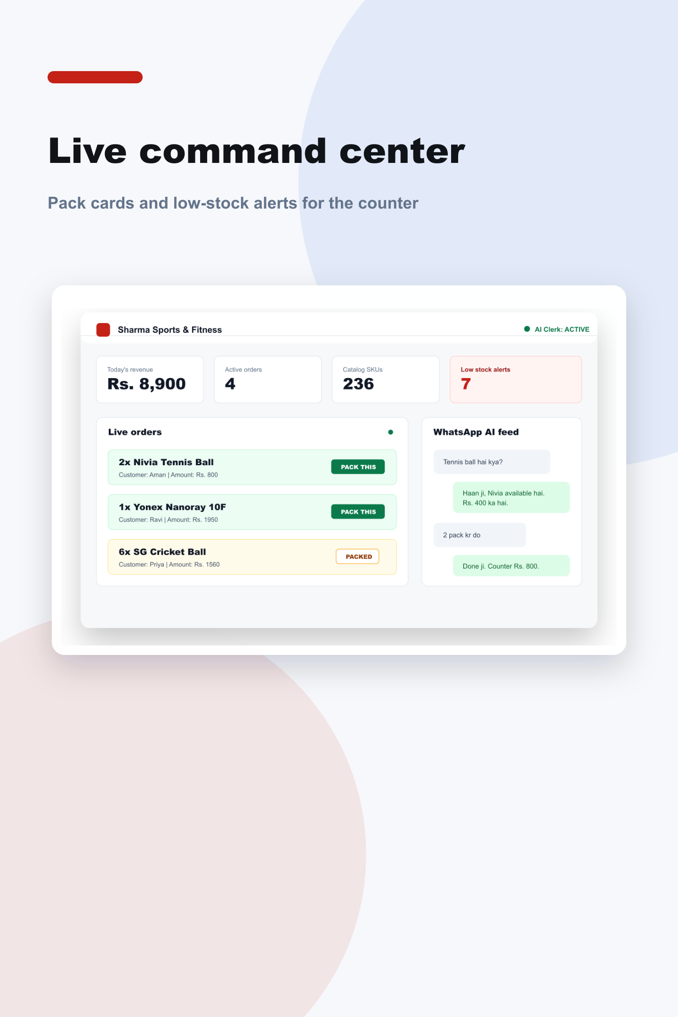






Every Confirmed Order Appears at the Counter.
Live Order Cards
Low-Stock Alerts
New pickup orders appear instantly with a notification sound.
Know what needs reordering before you run out.
Order Actions
Mark orders as Packed, Completed, or Cancelled with one tap.

Slide 7
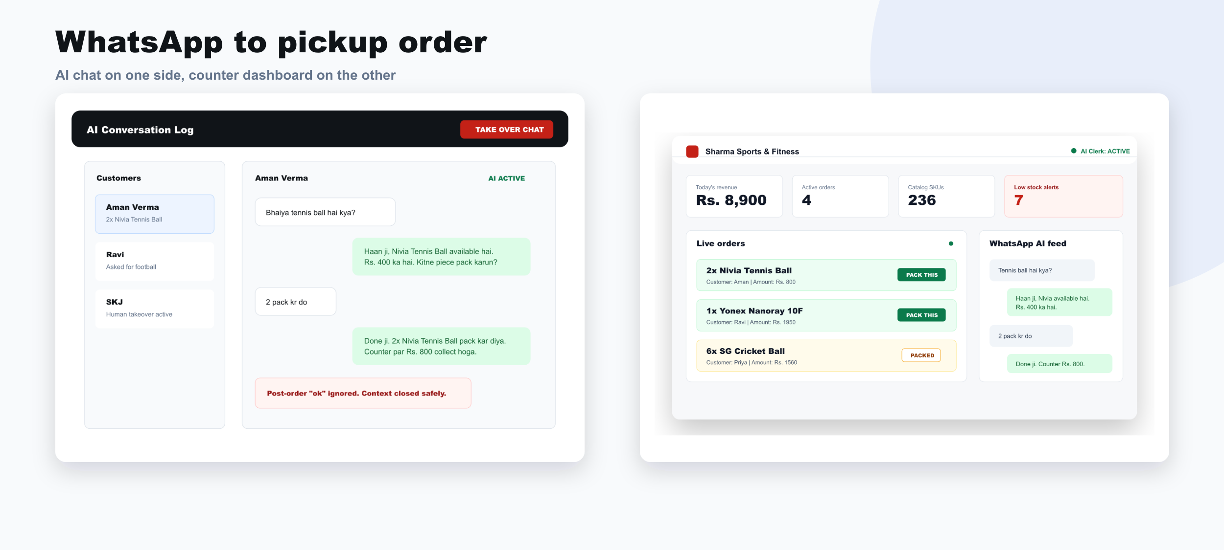





From Chat to Counter Order in Seconds.
The complete pickup flow — zero manual steps for your staff.
Customer Message
Quantity Confirm
Customer asks via WhatsApp
Customer confirms quantity
Pack Notification
AI Price Check
AI checks catalog and replies price
Dashboard shows PACK THIS ITEM amount
Example alert on dashboard: "New Order: 2× Nivia Tennis Ball — Collect ₹240. Customer: Rahul S."

Slide 8

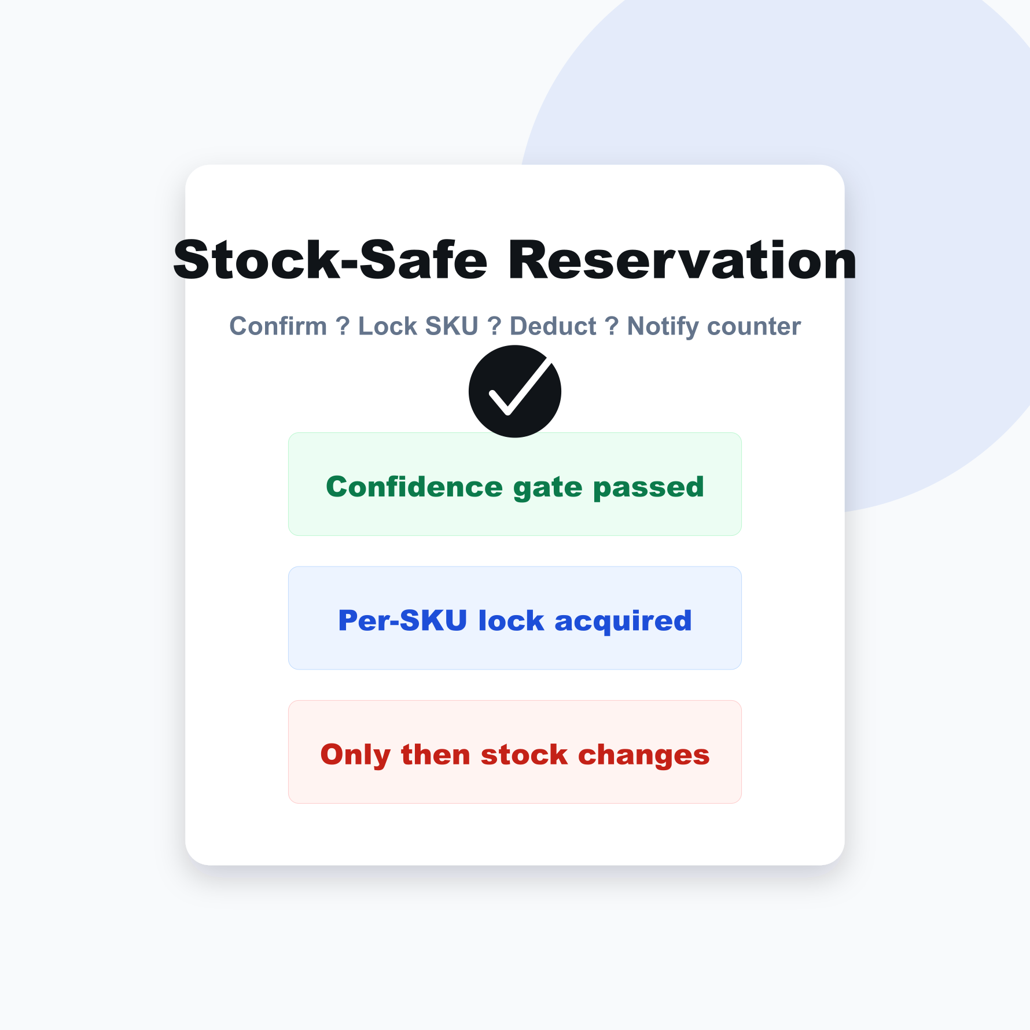
STOCK PROTECTION
No Accidental Double-Selling.
Smart Clerk's reservation system ensures your stock count is always accurate — even during peak hours.
Confident Confirmation Only
Per-SKU Locking
Smart Clarification
Stock deducted only when customer clearly confirms quantity.
Last item can't be reserved by two customers at the same time.
Vague messages trigger a follow-up question — never a deduction.

Slide 9
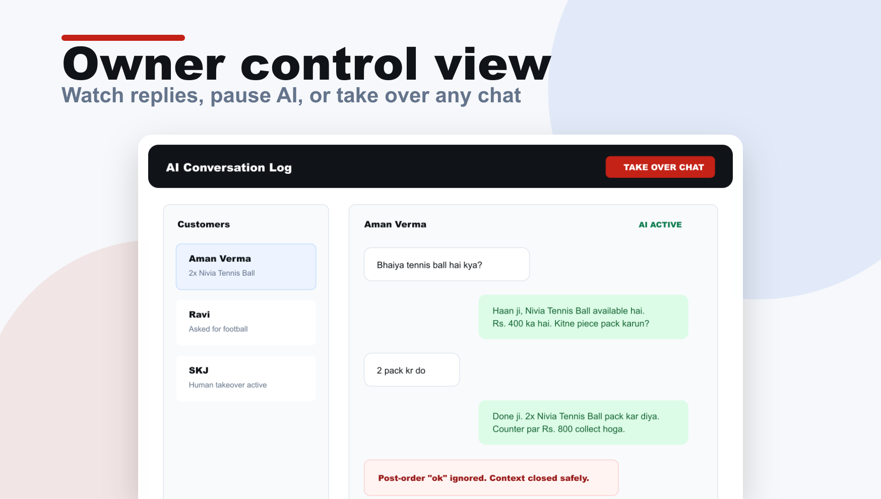

The Owner Is Always in Control.
Smart Clerk is AI-assisted, not AI-autonomous. Every decision stays with the owner.
Full Conversation Log
Every AI reply is visible and reviewable in your dashboard.
Take Over Chat
Disable AI for any individual customer and reply manually.
Global Pause
Pause the AI across all chats instantly — one tap.
Group chats and personal messages are automatically ignored.

Slide 10

Simple Pricing for First Shop Pilots.
No hidden charges. No lock-in surprises. Everything you need to go live.
Setup
Monthly Maintenance
₹6,999
₹1,999
One-time setup fee
Per month, after setup
Catalog setup & data import
Dashboard onboarding
WhatsApp demo flow
Pickup order system
AI monitoring & prompt tuning
Bug fixes & updates
Small workflow changes
Priority support
Start with one store. See results in the first week. Scale when ready.

